Slide 1
English Inflectional and Derivational Morphology
A Rule-Based Morphological Analysis System — Parsing Accuracy, Structural Complexity, and Statistical Validation
Name: ROHITH
Department: AIML
Roll Number: 2117240030118
Dataset
Inflectional Accuracy
1,000 English word forms analyzed
92.0% correctly parsed
Derivational Accuracy
Statistical Result
81.0% correctly parsed
p < 0.0001 — Null hypothesis rejected

Slide 2

Introduction & Project Objectives
Morphology studies the internal structure of words and how they are formed from smaller meaningful units called morphemes. This project develops a rule-based morphological analysis system and tests whether parsing accuracy differs significantly between inflectional and derivational categories.
Inflectional Morphology
Derivational Morphology
Modifies a word to express grammatical features — tense, number, person — without changing its part of speech. The base word retains its lexical category throughout the transformation.
Example: walk → walked (verb remains a verb; past tense marker added)
Creates new words with a different part of speech or substantially modified meaning. The transformation often introduces semantic and syntactic complexity that challenges rule-based systems.
Example: happy → happiness (adjective becomes noun)
Open-ended, productive processes
High rate of part-of-speech change
Irregular and context-sensitive patterns
Regular, predictable rule application
Low structural ambiguity
Closed set of affixes in English
Project Goal: Develop a rule-based morphological analysis system and test whether parsing accuracy differs significantly between inflectional and derivational word forms using statistical hypothesis testing.

Slide 3
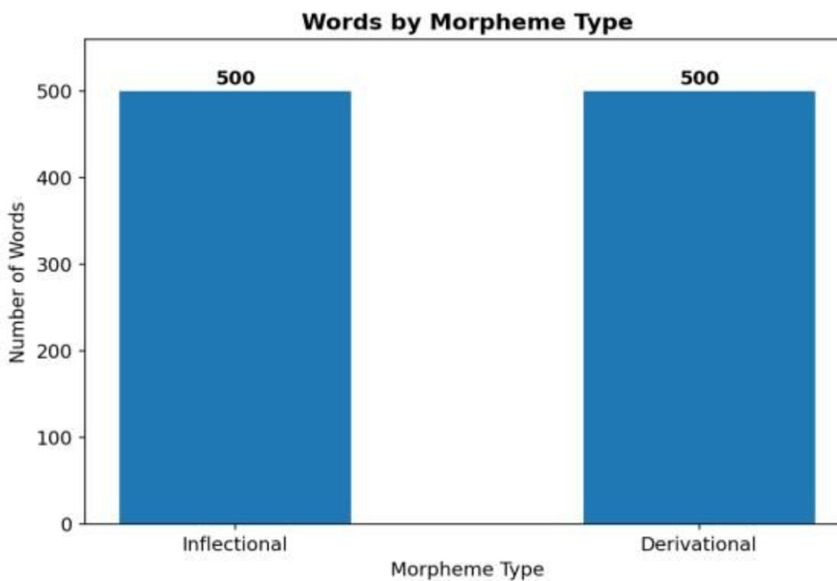
Dataset Overview
Dataset Composition
1,000
Total Records
English word forms analyzed
500
Inflectional
Word forms in category one
500
Derivational
Word forms in category two
12
Features
Variables per record
Variables Captured
Word form and base word
Affix type and position
Part-of-speech tag
Formation process category
Word length (characters)
Syllable count
Parsing accuracy (binary)

Slide 4
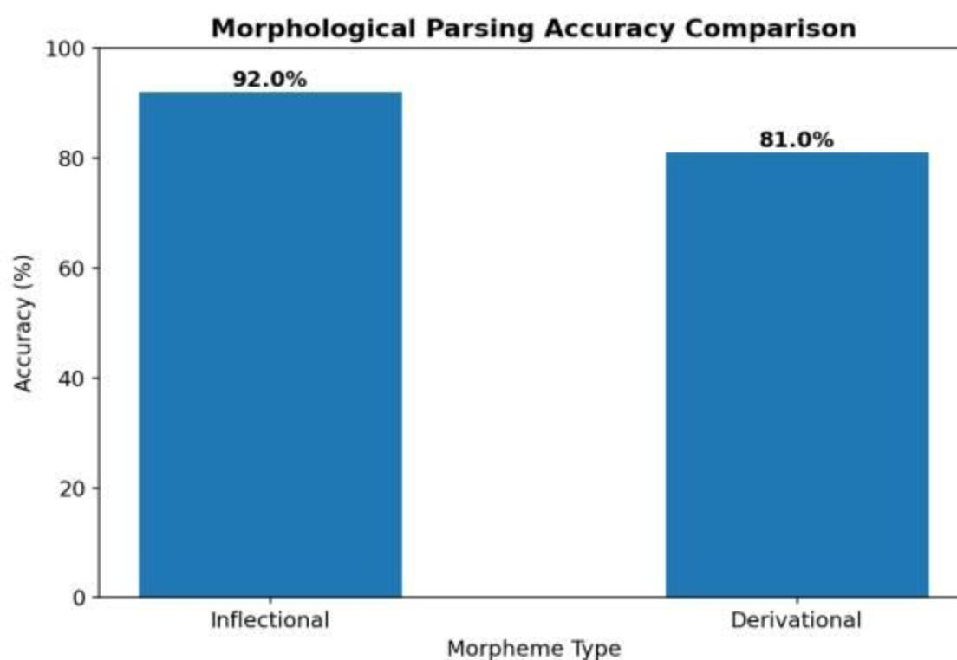


Parsing Accuracy Results
Accuracy Summary
Category | Correct | Total | Accuracy
Inflectional | 460 | 500 | 92.0%
Derivational | 405 | 500 | 81.0%
Gap | 55 forms | — | 11.0 pp
Interpretation
The rule-based system achieves strong performance on inflectional forms, where affix rules are regular and predictable. The 11.0 percentage point gap reflects the structural complexity introduced by derivational processes — particularly part-of-speech changes and irregular affix behavior.
92%
Inflectional
81%
Derivational

Slide 5
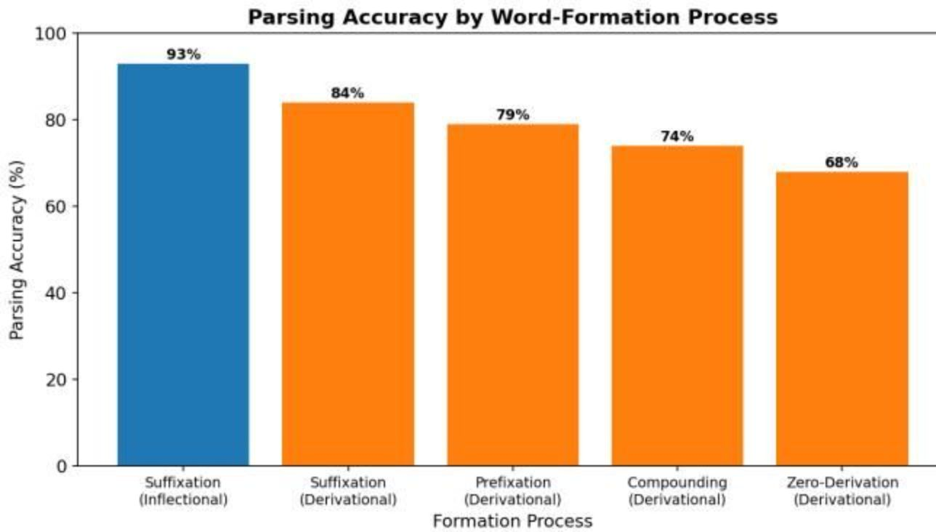
Structural Complexity & Formation Process Accuracy
Structural Metrics Compared
Accuracy by Formation Process
Metric | Inflectional | Derivational
Avg. Word Length | 6.8 chars | 8.4 chars
POS Change Rate | 4.0% | 78.0%
Process | Accuracy
Suffixation (Inflectional) | 93%
Suffixation (Derivational) | 84%
Prefixation | 79%
Compounding | 74%
Zero-Derivation | 68%
Zero-derivation — where no overt affix is added — presents the greatest challenge for rule-based systems, as there is no surface-level morphological signal to trigger parsing rules. Compounding similarly resists simple affix-matching approaches.

Slide 6
Statistical Hypothesis Testing
Hypotheses
Contingency Table
Null Hypothesis (H₀): There is no statistically significant difference in rule-based parsing accuracy between inflectional and derivational word forms.
Alternative Hypothesis (H₁): There is a statistically significant difference in rule-based parsing accuracy between inflectional and derivational word forms.
Category | Correct | Incorrect | Total
Inflectional | 460 | 40 | 500
Derivational | 405 | 95 | 500
Total | 865 | 135 | 1,000
Test Parameters
Decision Rule
Significance Level: α = 0.05
Test Used: Chi-square test of independence
Rationale: Comparing two categorical outcomes (correct/incorrect) across two independent groups (inflectional/derivational)
If the computed p-value falls below α = 0.05, we reject H₀ and conclude that the observed difference in parsing accuracy is unlikely to have arisen by chance. The chi-square statistic measures the deviation between observed and expected cell frequencies under the assumption of independence.

Slide 7

Statistical Test Results
25.9
<0.0001
χ² Statistic
p-value
Chi-square value computed from contingency table
Exact value: 0.0000004 — far below α = 0.05
11pp
95%
Observed Gap
Confidence Interval
Inflectional minus derivational accuracy
6.9% to 15.1% accuracy difference range
Decision
Confidence Interval Interpretation
Reject the null hypothesis. The difference in rule-based parsing accuracy between inflectional and derivational word forms is statistically significant at the 5% significance level. With a p-value of 0.0000004, the result is significant at the 0.01% level — providing overwhelming evidence against H₀.
The 95% confidence interval of 6.9% to 15.1% indicates that the true population-level accuracy gap between inflectional and derivational parsing lies within this range. Because the interval does not include zero, we can be confident the difference is real and practically meaningful, not a sampling artifact.
Conclusion: The rule-based system's superior performance on inflectional forms is not due to chance. The structural regularity of inflectional morphology provides a genuine parsing advantage that is statistically confirmed.

Slide 8

Key Findings & Recommendations
Core Findings
Recommendations for System Improvement
Accuracy Gap Confirmed
1
Expand Derivational Affix Dictionary
Inflectional 92.0% vs. Derivational 81.0% — an 11.0 percentage point gap that is statistically significant at p < 0.0001 with a 95% CI of 6.9%–15.1%.
Systematically catalogue derivational affixes with their associated POS transformation rules to improve coverage of the 81% baseline.
2
Introduce POS-Aware Rules
POS Change as Key Driver
Incorporate part-of-speech context into the parsing pipeline so that affix rules are conditioned on the syntactic category of the base word.
Derivational affixes change part of speech in 78% of cases vs. only 4% for inflectional affixes — the primary source of rule-based system failure.
3
Neural Morphological Segmentation
For low-accuracy categories — particularly zero-derivation (68%) and compounding (74%) — integrate neural segmentation models to handle irregular and context-sensitive patterns beyond rule-based reach.
Formation Process Hierarchy
Accuracy declines from suffixation (93%) through prefixation (79%) and compounding (74%) to zero-derivation (68%), reflecting increasing rule complexity.
The rule-based analyzer performs reliably on inflectional forms but requires further development for derivational morphology due to structural complexity and irregular patterns. A hybrid approach combining rule-based and neural methods is the recommended path forward.

Slide 9
Student Information
Name
Department
Roll Number
ROHITH
AIML
2117240030118

